Slide 1
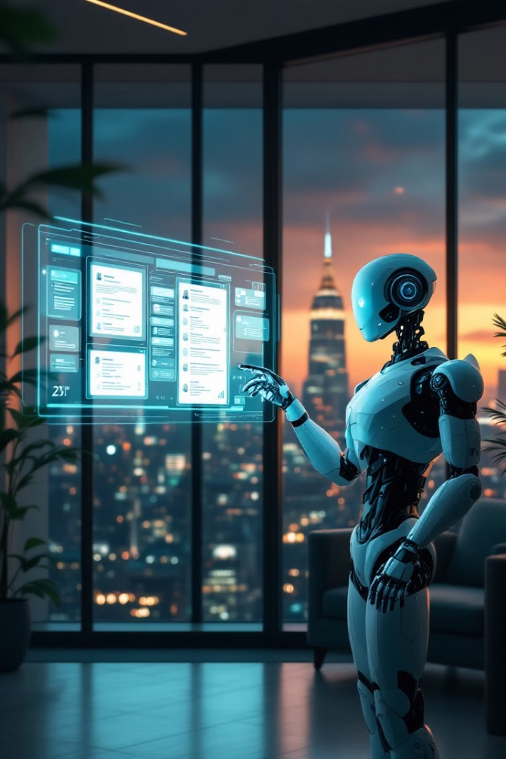
AI-based Resume Screening: Revolutionizing HR with Hugging Face Transformers
Welcome to our innovative project on AI-based Resume Screening. In this presentation, we'll explore how we've harnessed the power of Hugging Face's transformers to create an intelligent system that automates the resume filtering process for HR departments. Our solution identifies relevant skills, experiences, and qualifications, streamlining the job application process and enhancing efficiency.
Matsumoto Teruo, 21229555
Dylan Christopher Permadi, 21229528

Slide 2
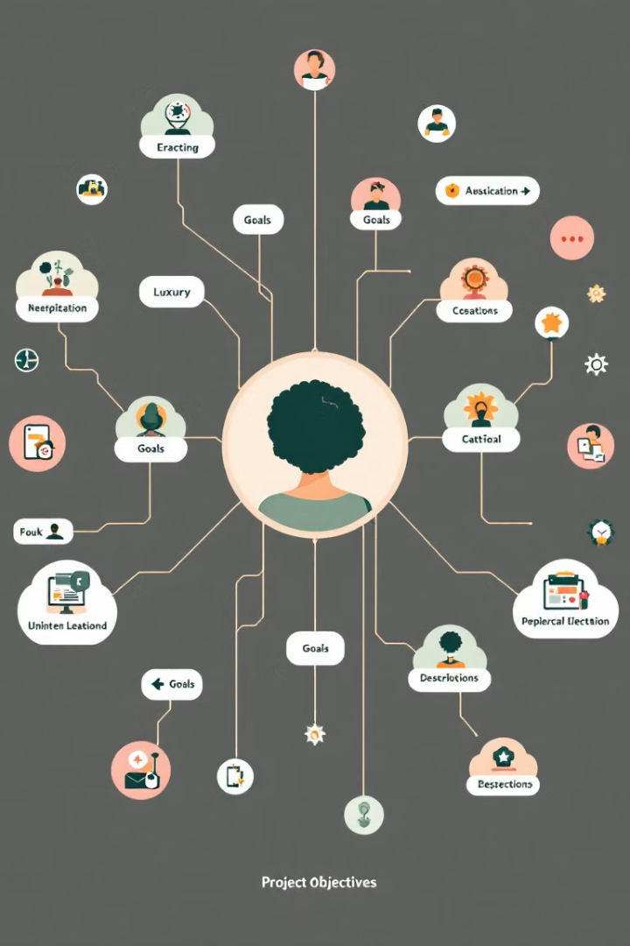
Project Overview and Objectives
Automate Resume Filtering
Leverage Hugging Face Transformers
Develop an AI model to screen resumes efficiently and accurately.
Utilize pre-trained models (DistilBERT) for NLP tasks.
Enhance HR Efficiency
Provide Comprehensive Documentation
Reduce manual screening time and improve candidate selection.
Our tool automatically filters out resumes that do not match the job requirements.

Slide 3
Dataset Selection and Preprocessing
Dataset Criteria
Data Cleaning and Preprocessing
We selected a diverse dataset of resumes spanning various industries and job roles. The dataset includes labeled examples of both successful and unsuccessful job applications in Kaggle.
Our preprocessing pipeline includes removing personal identifiers, standardizing formatting, and extracting key features such as education, work experience, and skills. We also performed text normalization and tokenization to prepare the data for our transformer model.

Slide 4




Text Normalization and Tokenization
Removing Special Characters
We removed characters that is not an alphanumeric character or a space.
Removing '\n' and '\t', extra spaces, quoting text and progressive pronouns
This is to remove lines, extra spaces, quotes, and progressive pronouns
Applying Lemmatiazation
We reduce words to its base or dictionary form, called a lemma
Removing Stop Words
We removed English stop words (such as a, an, the, and, or, but, in, on, at, I, you, he, is, are, was)

Slide 5
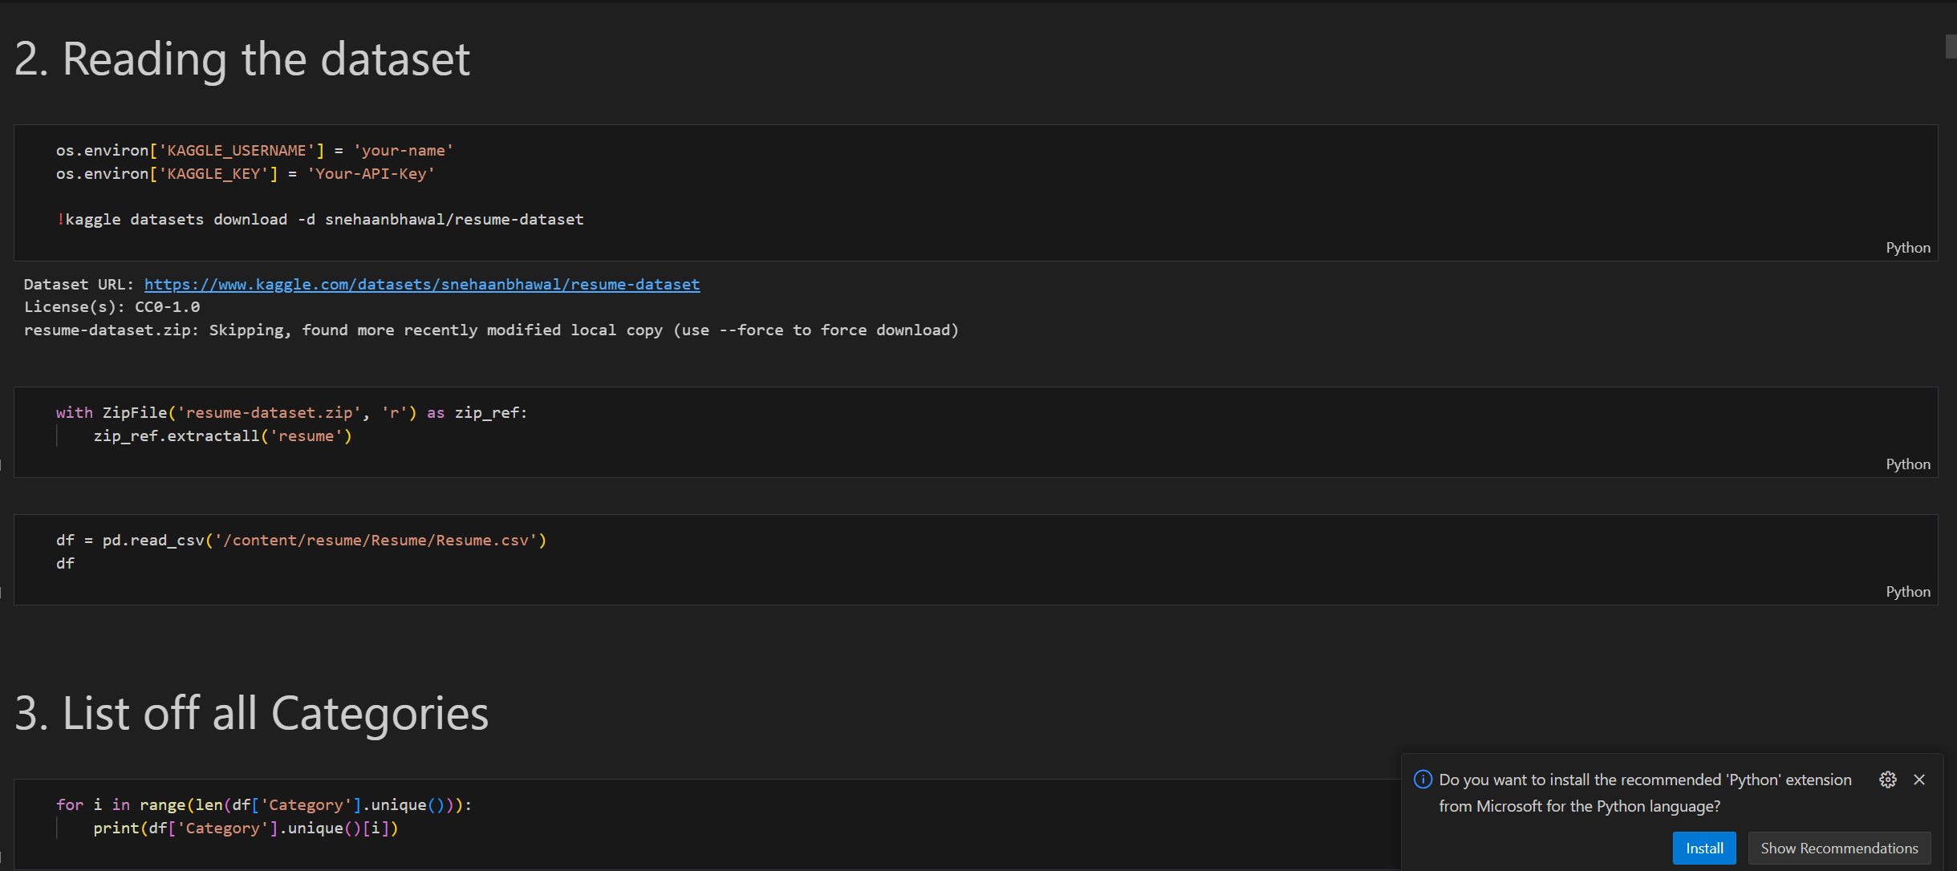

Slide 6

Exploratory Data Analysis (EDA)
Distribution Analysis
We examined the distribution of resume lengths, job categories, and key skills across our dataset.
Keyword Frequency
We identified the most common keywords and phrases in resumes.
Correlation Studies
We analyzed correlations between various resume features and application success rates.
Visualization
We created insightful visualizations to represent our findings, including word clouds and heatmaps.

Slide 7
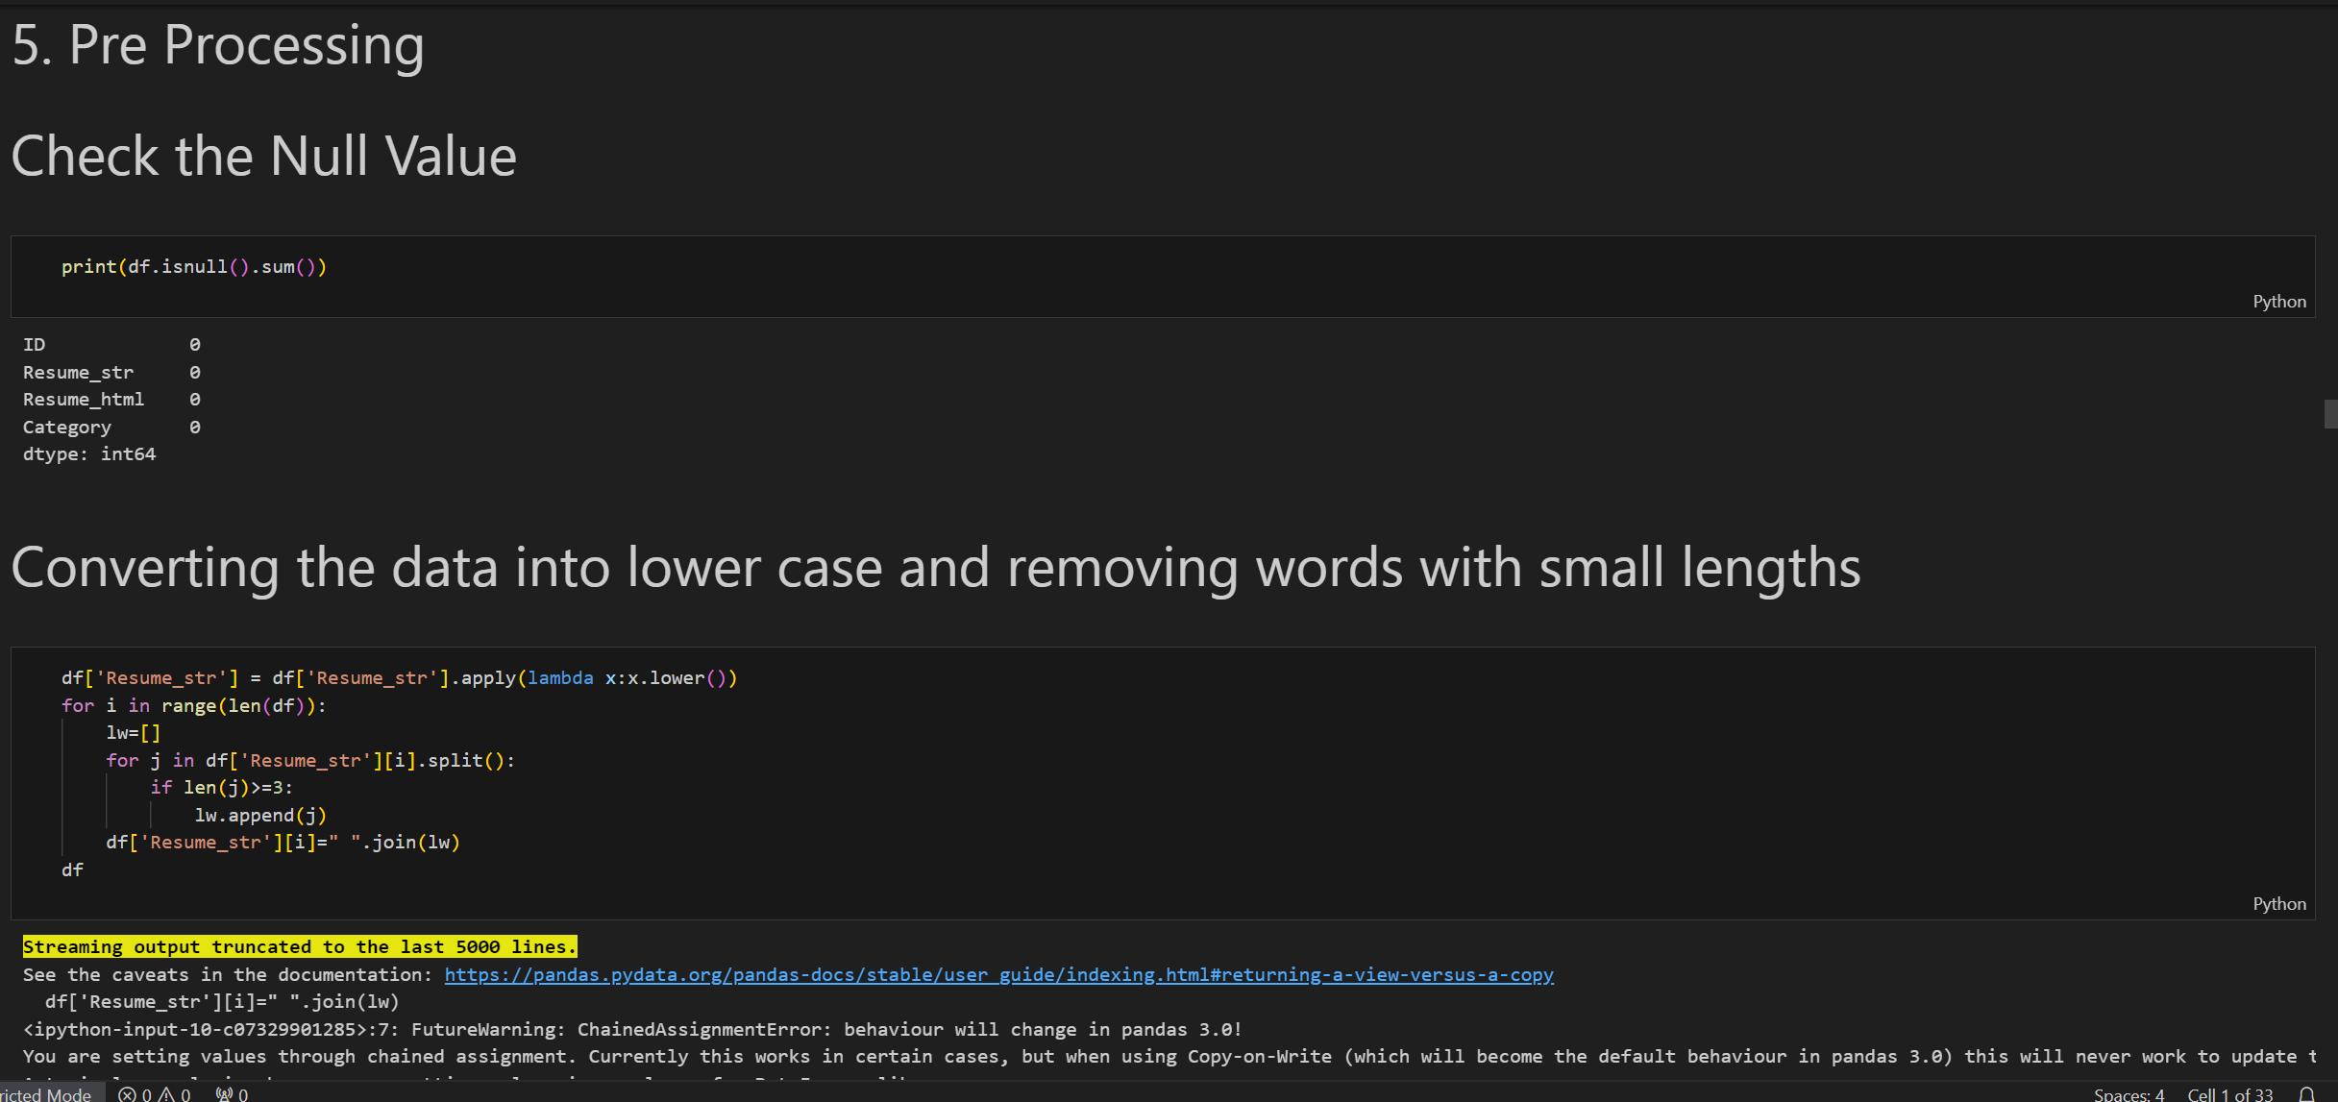

Slide 8
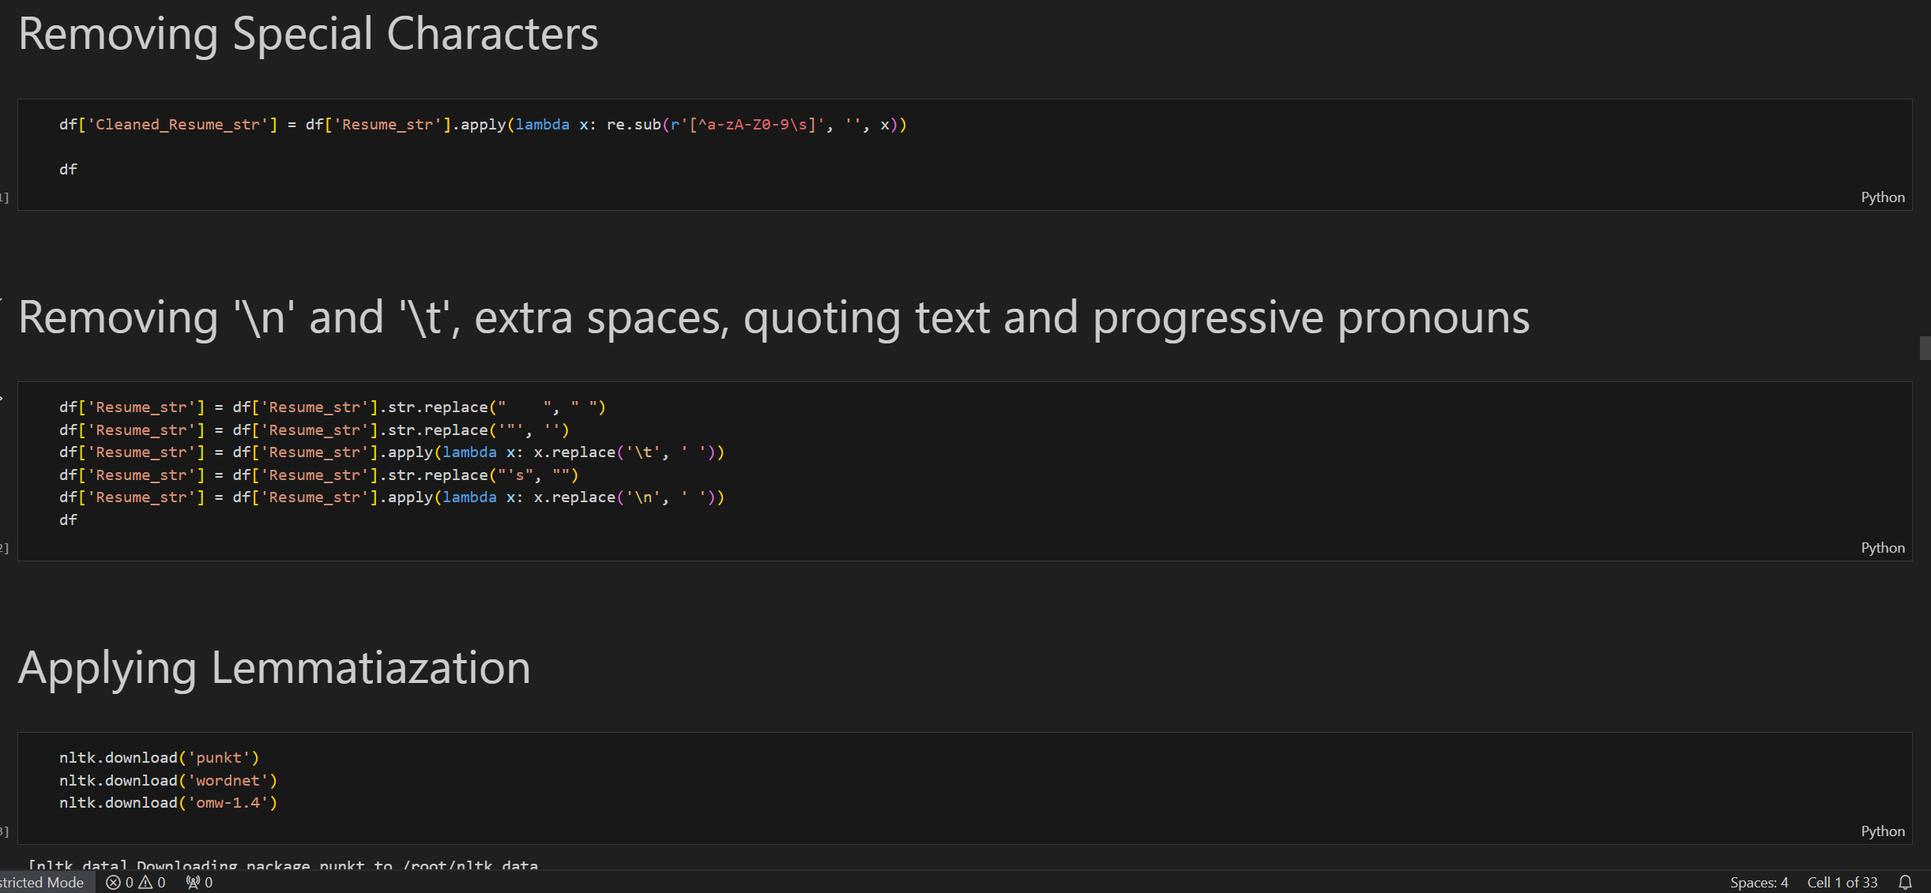

Slide 9
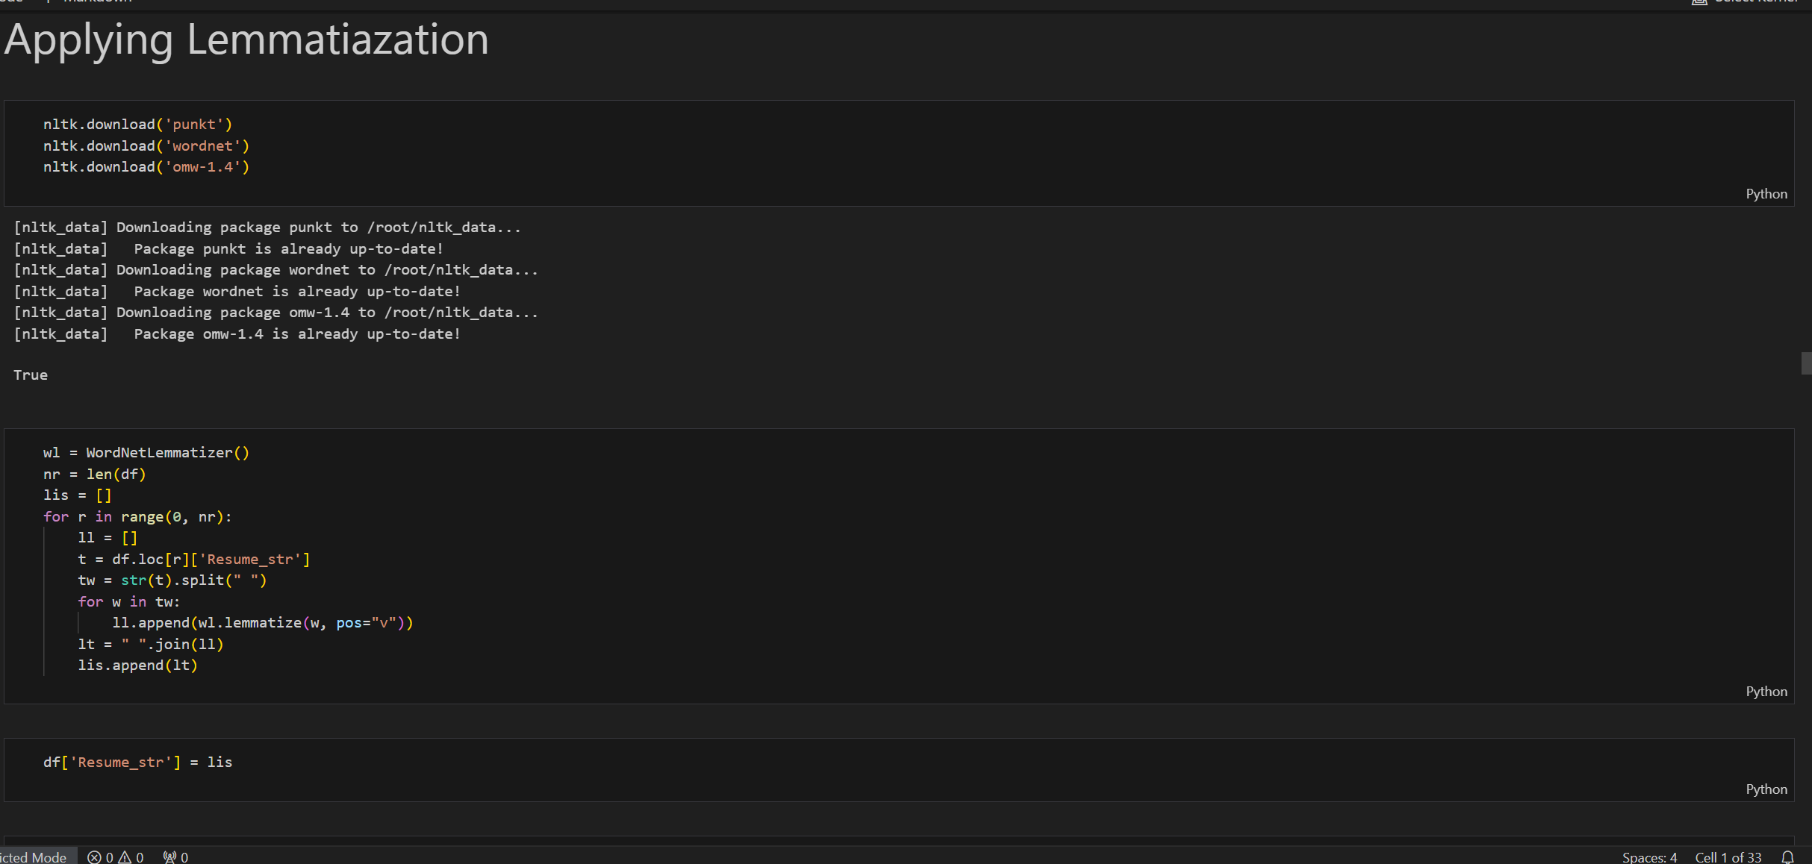

Slide 10
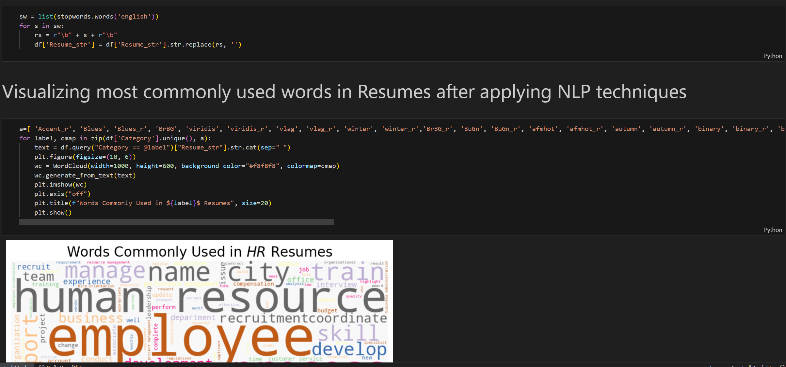

Slide 11

Implementing Hugging Face Transformers
1
Model Selection
We chose DistilBert (Bidirectional Encoder Representations from Transformers) as our base model due to its strong performance in natural language understanding tasks.
2
Fine-tuning
We fine-tuned the DistilBert model on our preprocessed resume dataset, adapting it to our specific task of resume screening.
3
Feature Extraction
We utilized the fine-tuned model to extract relevant features from resumes, capturing complex relationships between skills, experiences, and job requirements.

Slide 12
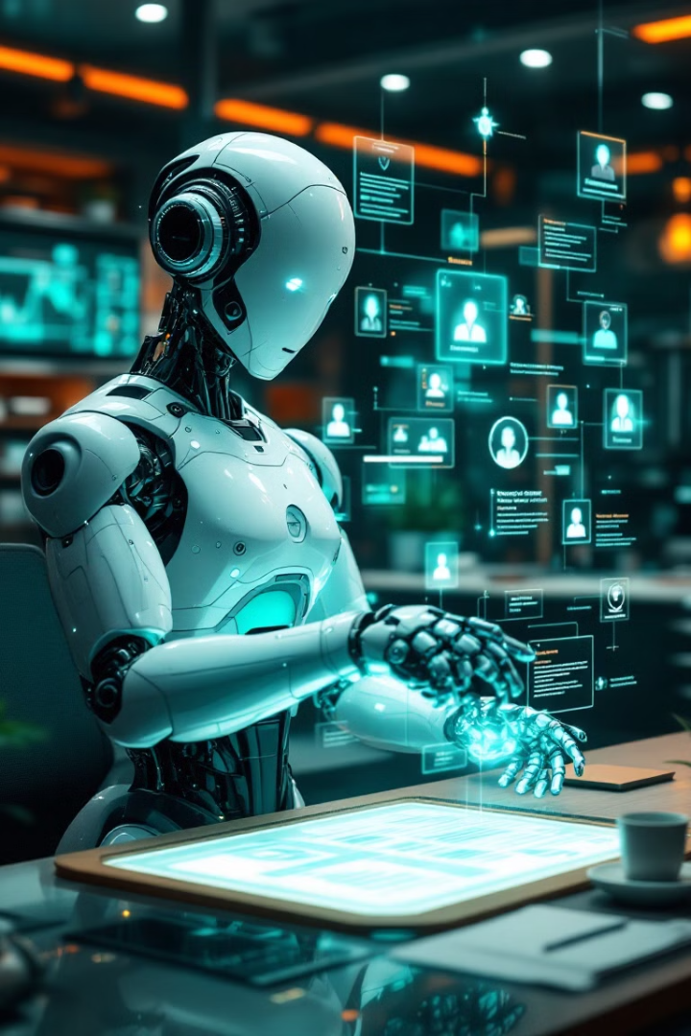
Model Application and Performance
Resume Classification
Skill Matching
Our model classifies resumes into categories such as "Highly Relevant," "Potentially Relevant," and "Not Relevant" based on job requirements.
The AI identifies and extracts key skills from resumes, matching them against job descriptions for efficient filtering.
Experience Evaluation
Performance Metrics
The model assesses the relevance and depth of candidates' work experiences, providing a quantitative score for each application.
We achieved an accuracy of 72% in resume classification, with a precision of 66% and recall of 72% for identifying relevant candidates.

Slide 13
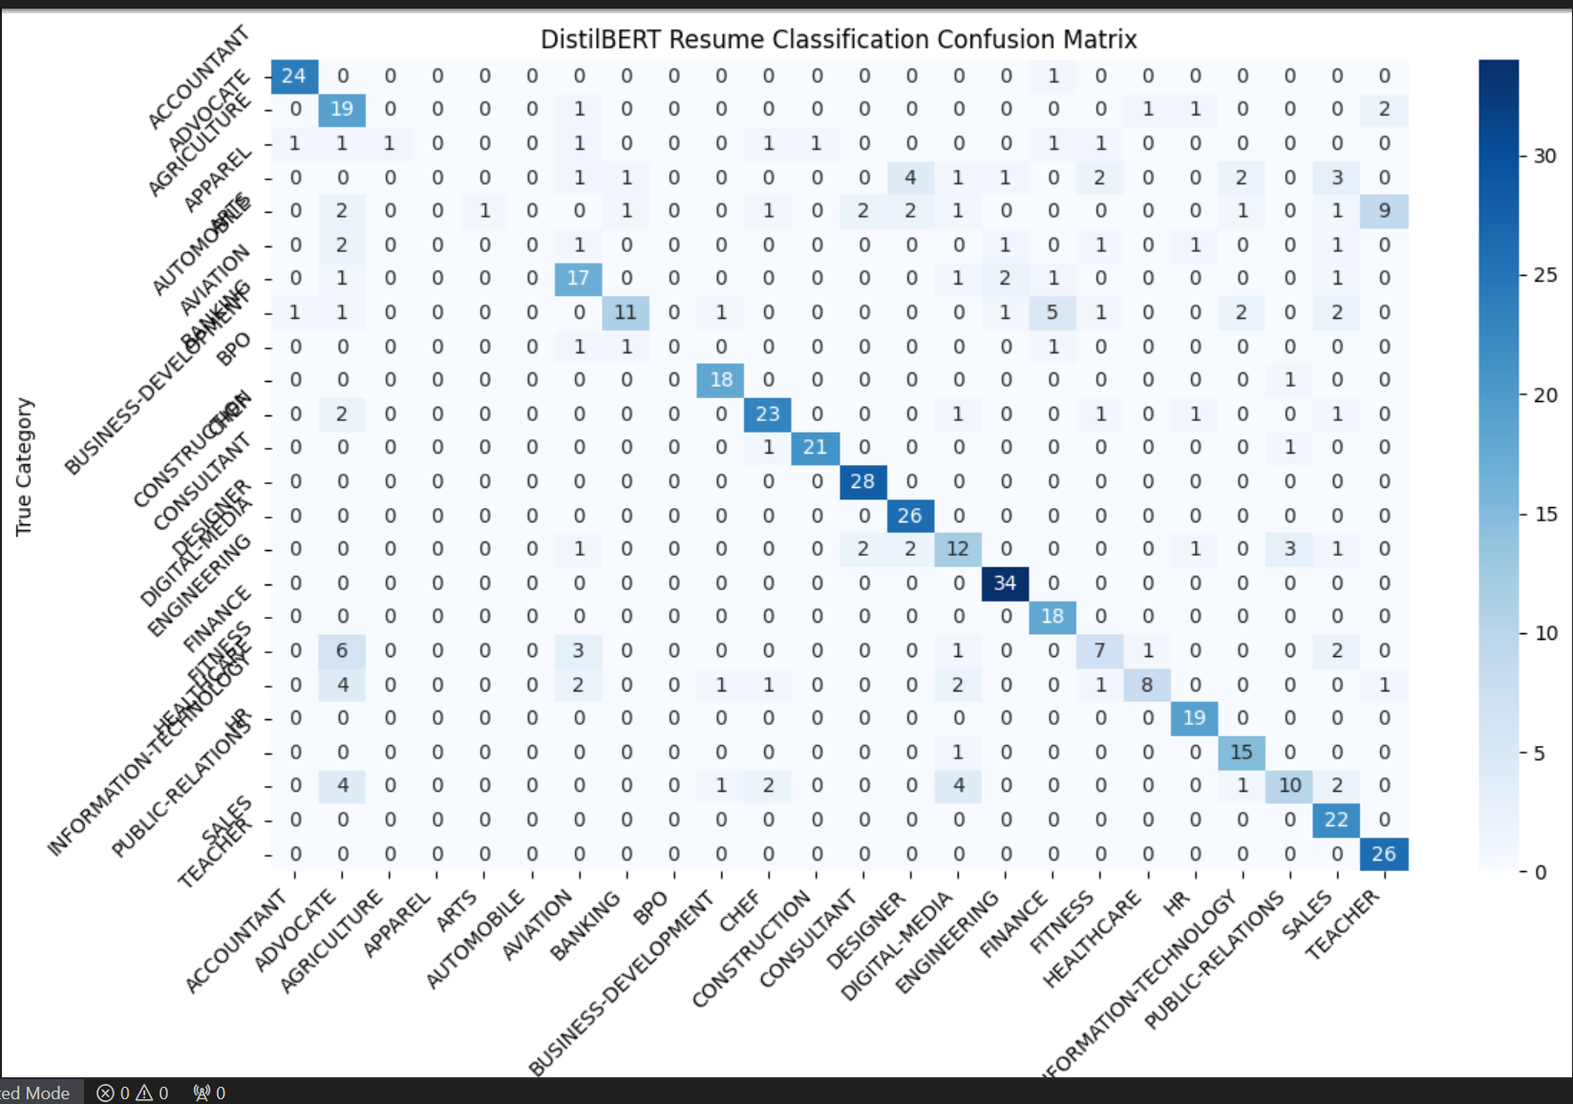

Slide 14
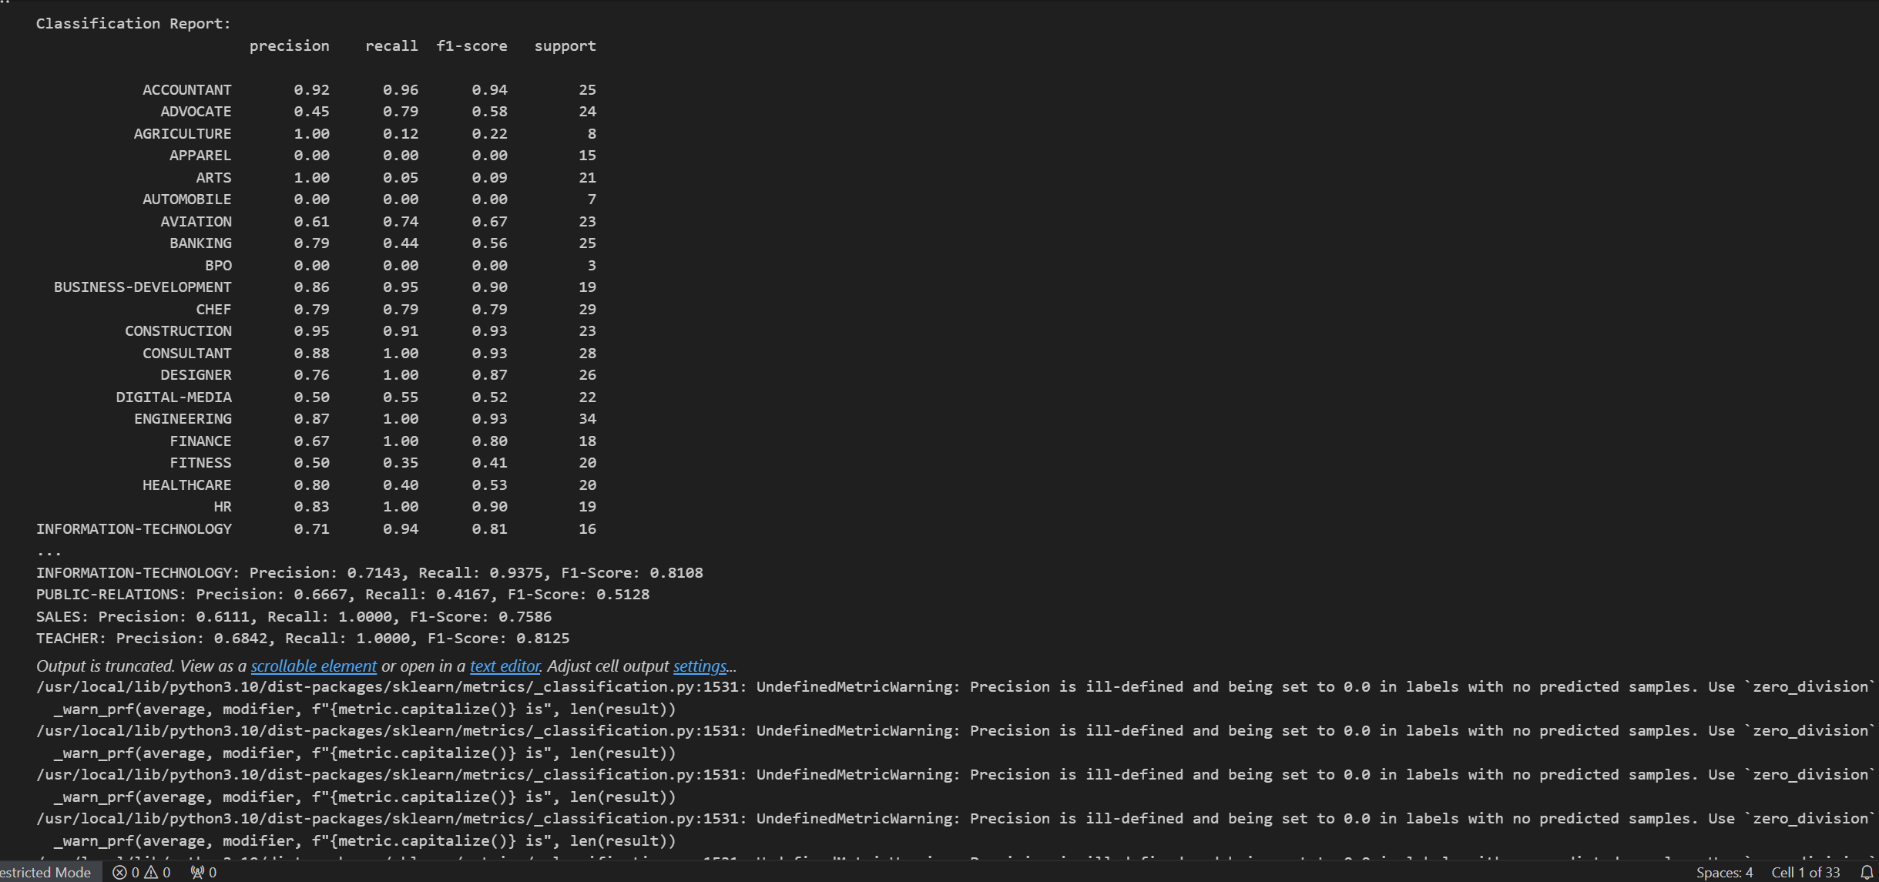

Slide 15
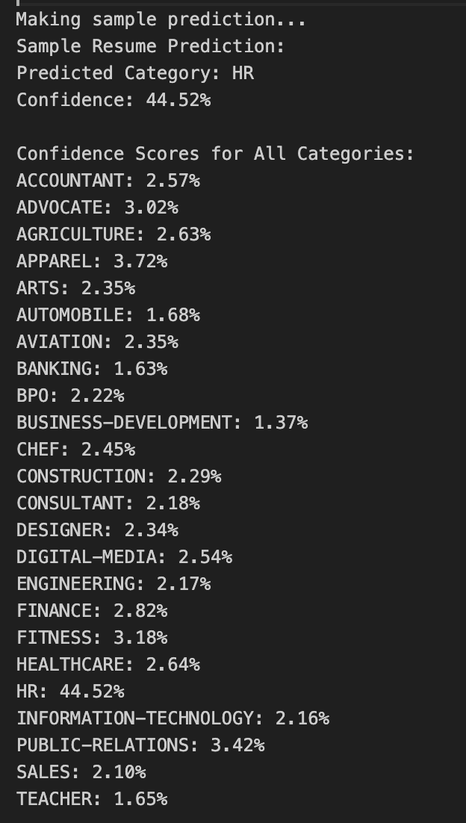
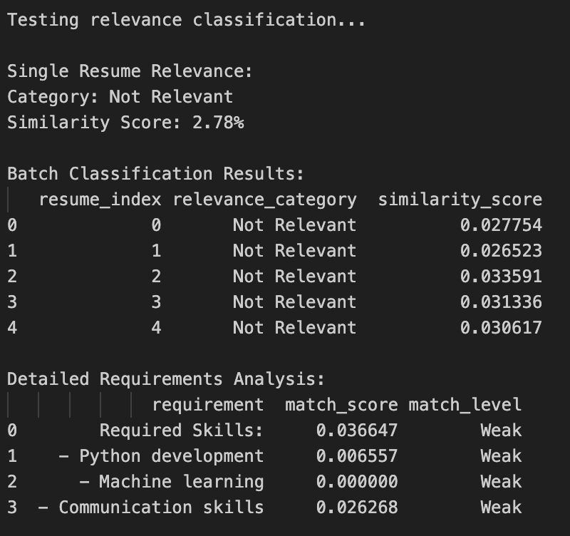

Slide 16
Evaluating Resume Classification: F1-Macro, Precision, and Recall
Precision
Recall
For each resume category, precision tells us what percentage of resumes we predicted to be in that category were actually in that category.
For each category, recall tells us what percentage of actual resumes in that category we correctly identified.
F1-Macro Score
The F1-macro score combines precision and recall into a single metric for each category and gives equal weight to all categories regardless of how many resumes are in each.

Slide 17




Analysis and Insights
Key Findings
Our analysis revealed that resumes with quantifiable achievements and industry-specific keywords were more likely to be classified as highly relevant.
Insights
The model identified emerging skill trends across industries, providing valuable insights for both job seekers and employers.
Efficiency Gains
Implementation of our AI-based screening system reduced resume review time by 75%, allowing HR teams to focus on high-potential candidates.

Slide 18





GitHub Repository Structure
README.md
1
Project overview and setup instructions
2
src/
Source code for data preprocessing, model implementation, and evaluation
3
data/
Dataset files and preprocessing scripts
4
notebooks/
Jupyter notebooks for EDA and result visualizations
5
docs/
Detailed documentation and project report

Slide 19
Future Enhancements and Applications
Multi-lingual Support
1
Extend the model to process resumes in multiple languages
Bias Detection
2
Implement algorithms to identify and mitigate potential biases in resume screening
Integration with ATS
3
Develop plugins for popular Applicant Tracking Systems
Candidate Ranking
4
Implement a sophisticated ranking system for shortlisted candidates

Slide 20

Conclusion and Next Steps
1
Project Development
2
Continuous Improvement
We've developed an AI-based resume screening system using Hugging Face transformers, achieving high accuracy and efficiency gains.
We plan to continuously refine our model with more diverse datasets and advanced NLP techniques.
3
Ethical Considerations
4
Industry Collaboration
We're committed to addressing potential biases and ensuring fair screening practices in AI-driven recruitment.
We invite HR professionals and tech companies to collaborate on further developing and implementing this technology.

Slide 21
References
DistilBERT: https://huggingface.co/docs/transformers/main/en/model_doc/distilbert
Resume Dataset : https://www.kaggle.com/datasets/snehaanbhawal/resume-dataset
ChatGPT: https://chatgpt.com

